Slide 1
Boosting Algorithm
Types of Boosting Algorithm
Ada Boost
xg boost
Lg Boost

Slide 2
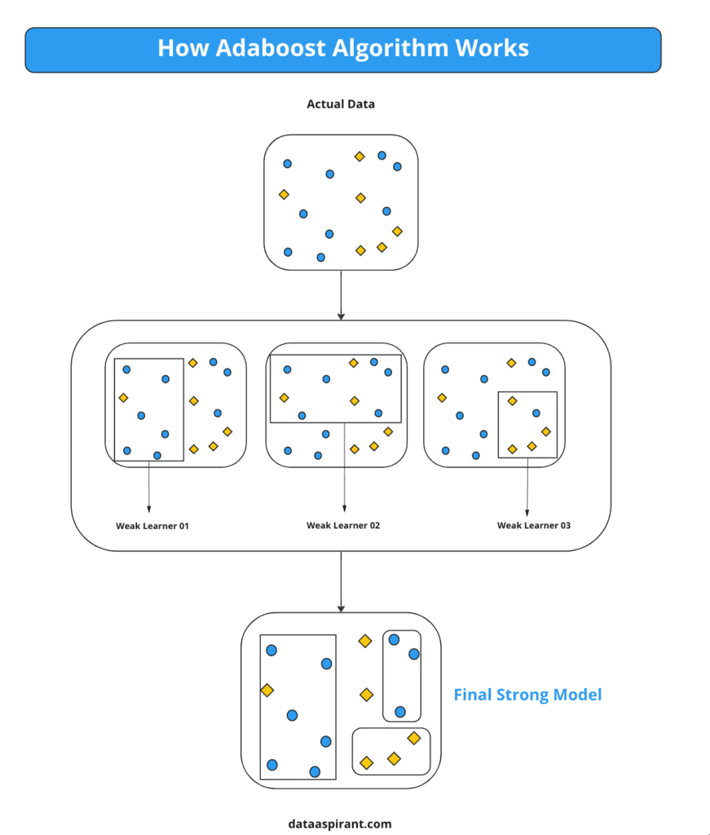
ADA Boosting
Its combines multiple weak classifiers to create a strong learner
It can learn from the mistakes made by the weak classifiers and produce a strong model that can generalize well on new data

Slide 3
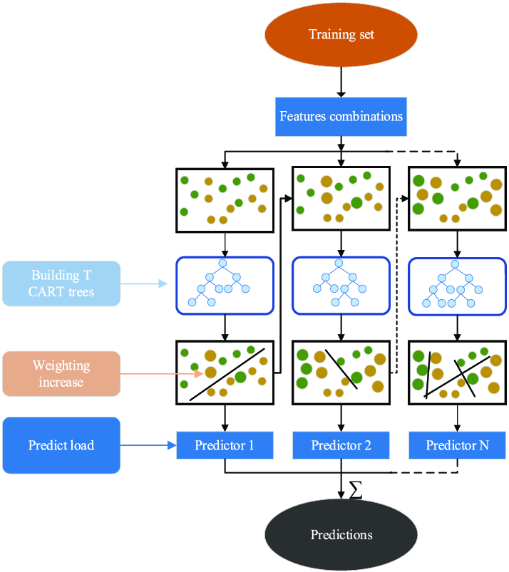
XG Boost
It builds decision trees sequentially with each tree attempting to correct the mistakes made by the previous one.
Steps involved in XG Boost algorithm are,
Start with a base learner:
Calculate the errors:
Train the next tree
Repeat the process
Combine the predictions.

Slide 4
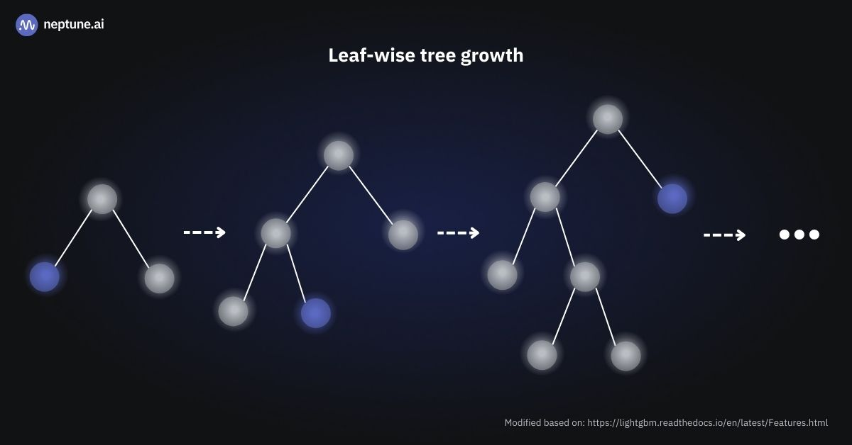
LG Boost
It distributed high-performance framework that uses decision trees for ranking, classification, and regression tasks
LightGBM carries out leaf-wise (vertical) growth that results in more loss reduction and, in turn, higher accuracy while being faster.

Slide 5
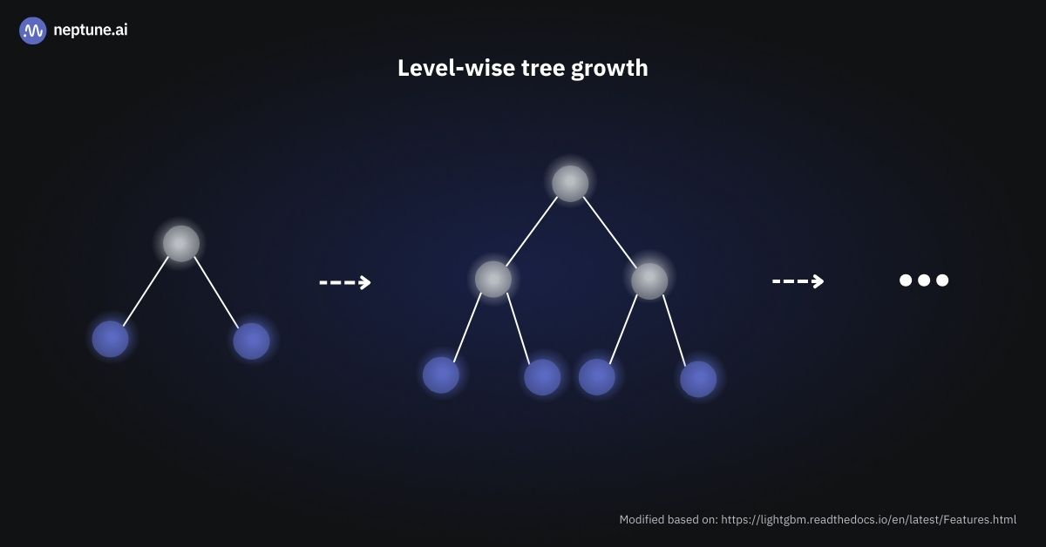
XGBoost vs LightGBM
XG Boost(Level wise tree Growth)
LG BOOST(leaf wise tree growth)

